Slide 1
Reduction of ER Model to Relational Model

Slide 2
ER-to-Relational Mapping Algorithm
Mapping of Regular Entity Types
Mapping of Weak Entity Types
Mapping of Binary 1:1 Relation Types
Mapping of Binary 1:N Relationship Types
Mapping of Binary M:N Relationship Types
Mapping of Multivalued attributes
Mapping of N-ary Relationship Types
Options for Mapping Specialization or Generalization
Mapping of Aggregation

Slide 3
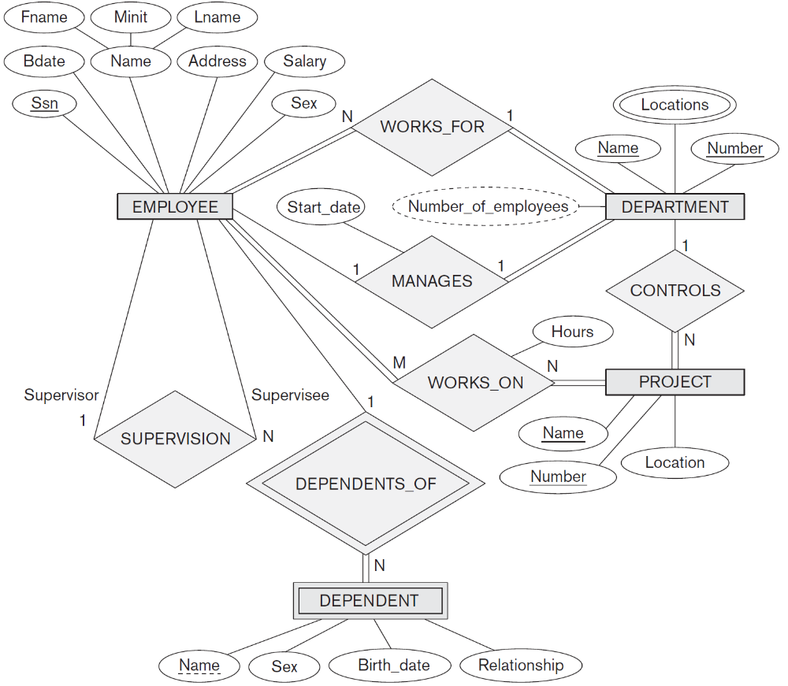
The ER conceptual schema diagram for the COMPANY database

Slide 4
Mapping of Regular Entity Types
For each regular (strong) entity type E in the ER schema, create a relation R that includes all the simple attributes of E.
Include only the simple component attributes of a composite attribute.
Choose one of the key attributes of E as the primary key for R.
If the chosen key of E is a composite, then the set of simple attributes that form it will together form the primary key of R.

Slide 5
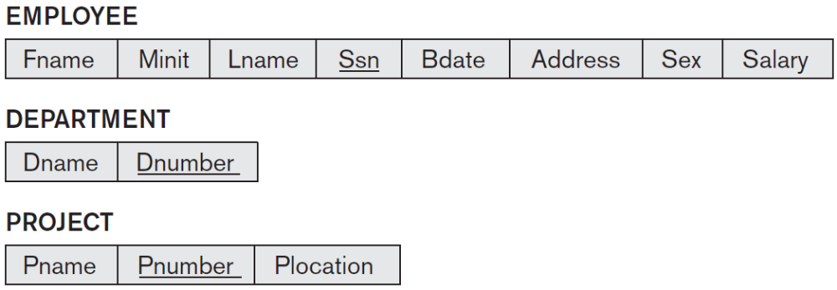
Mapping of Regular Entity Types
Example
  We create the relations EMPLOYEE, DEPARTMENT, and PROJECT in the relational schema corresponding to the regular entities in the ER diagram.
  SSN, DNUMBER, and PNUMBER are the primary keys for the relations EMPLOYEE, DEPARTMENT, and PROJECT as shown.

Slide 6
Mapping of Weak Entity Types
For each weak entity type W in the ER schema with owner entity type E, create a relation R and include all simple attributes (or simple components of composite attributes) of W as attributes of R.
Include as foreign key attributes of R the primary key attribute(s) of the relation(s) that correspond to the owner entity type(s).
The primary key of R is the combination of the primary key(s) of the owner(s) and the partial key of the weak entity type W, if any.
If there is a weak entity type E₂ whose owner is also a weak entity type E₁, then E₁ should be mapped before E₂ to determine its primary key first.

Slide 7
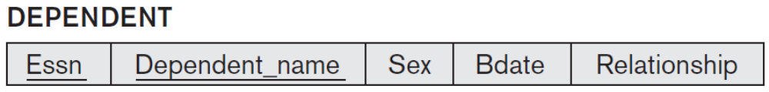
Mapping of Weak Entity Types
Example
  Create the relation DEPENDENT correspond to the weak entity type DEPENDENT.
  Include the primary key SSN of the EMPLOYEE relation as a foreign key attribute of DEPENDENT (renamed to ESSN).
  The primary key of the DEPENDENT relation is the combination {ESSN, DEPENDENT_NAME} because DEPENDENT_NAME is the partial key of DEPENDENT.

Slide 8
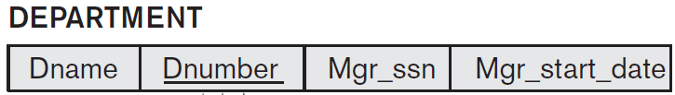
Mapping of Binary 1:1 Relationship Types
For each binary 1:1 relationship type R in the ER schema, identify the relations S and T that correspond to the entity types participating in R.
There are three possible approaches:
  Foreign Key (2 relations) approach: Choose one of the relations, say S and include a foreign key in S the primary key of T. It is better to choose an entity type with total participation in R in the role of S.
  Example
    1:1 relation MANAGES is mapped by choosing the participating entity type DEPARTMENT to serve in the role of S, because its participation in the MANAGES relationship type is total.
    Include the primary key of the EMPLOYEE relation as foreign key in the DEPARTMENT relation.
    Include simple attribute Start_date of MANAGES relationship type in DEPARTMENT relation.

Slide 9
Mapping of Binary 1:1 Relationship Types
Merged relation (1 relation) option: An alternate mapping of a 1:1 relationship type is possible by merging the two entity types and the relationship into a single relation. This may be appropriate when both participations are total.
Cross-reference or relationship relation (3 relations) option: The third alternative is to set up a third relation R for the purpose of cross-referencing the primary keys of the two relations S and T representing the entity types.

Slide 10
Mapping of Binary 1:N Relationship Types
For each regular binary 1:N relationship type R, identify the relation S that represent the participating entity type at the N-side of the relationship type.
Include as foreign key in S the primary key of the relation T that represents the other entity type participating in R.
Include any simple attributes of the 1:N relation type as attributes of S.
Example
  1:N relationship types WORKS_FOR, CONTROLS, and SUPERVISION.
  For WORKS_FOR we include the primary key DNUMBER of the DEPARTMENT relation as foreign key in the EMPLOYEE relation.

Slide 11
Mapping of Binary M:N Relationship Types
For each regular binary M:N relationship type R, create a new relation S to represent R. This is a relationship relation.
Include as foreign key attributes in S the primary keys of the relations that represent the participating entity types; their combination will form the primary key of S.
Also include any simple attributes of the M:N relationship type (or simple components of composite attributes) as attributes of S.
Example
  M:N relationship type WORKS_ON is mapped by creating a relation WORKS_ON in relational database schema.
  The primary keys of the PROJECT and EMPLOYEE relations are included as foreign keys in WORKS_ON.
  Attribute HOURS in WORKS_ON represents the HOURS attribute of the relation type. The primary key of the WORKS_ON relation is combination of foreign key attributes {ESSN, PNO}.

Slide 12
Mapping of Multivalued attributes
For each multivalued attribute A, create a new relation R.
R will include an attribute corresponding to A, plus the primary key attribute K as foreign key in R of the relation that represents the entity type or relationship type that has A as a multivalued attribute.
The primary key of R is the combination of A and K.
If the multivalued attribute is composite, we include its simple components.
Example
  The relation DEPT_LOCATIONS is created.
  DLOCATION represents the multivalued attribute LOCATIONS of DEPARTMENT, while DNUMBER as foreign key represents primary key of DEPARTMENT relation.
  Primary key of R is the combination of {DNUMBER, DLOCATION}.

Slide 13
Mapping of N-ary Relationship Types
For each n-ary relationship type R, where n>2, create a new relationship S to represent R.
Include as foreign key attributes in S the primary keys of the relations that represent the participating entity types.
Include any simple attributes of the n-ary relationship type (or simple components of composite attributes) as attributes of S.
Example
  The relationship type SUPPLY in next slide.
  This can be mapped to relation SUPPLY shown in the relational schema, whose primary key is combination of three foreign keys {SNAME, PARTNO, PROJNAME}.

Slide 14
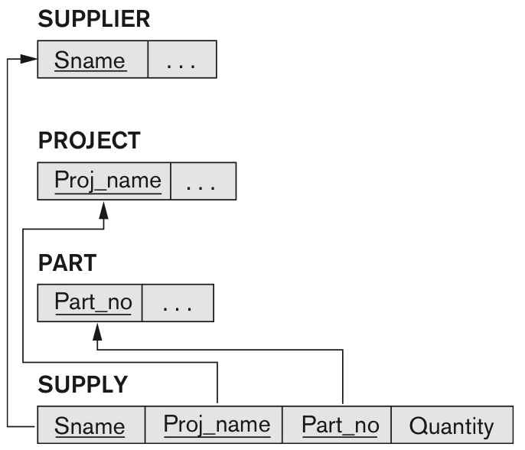
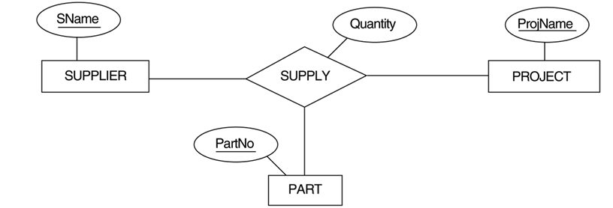
Mapping of N-ary Relationship Types

Slide 15
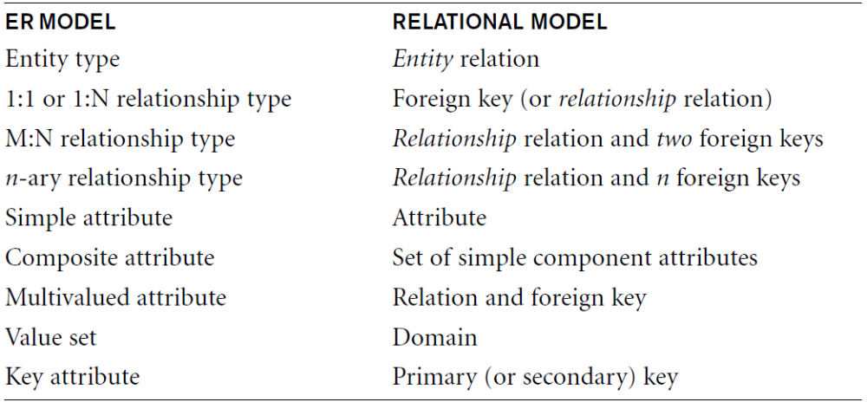
Correspondence between ER and Relational Models

Slide 16
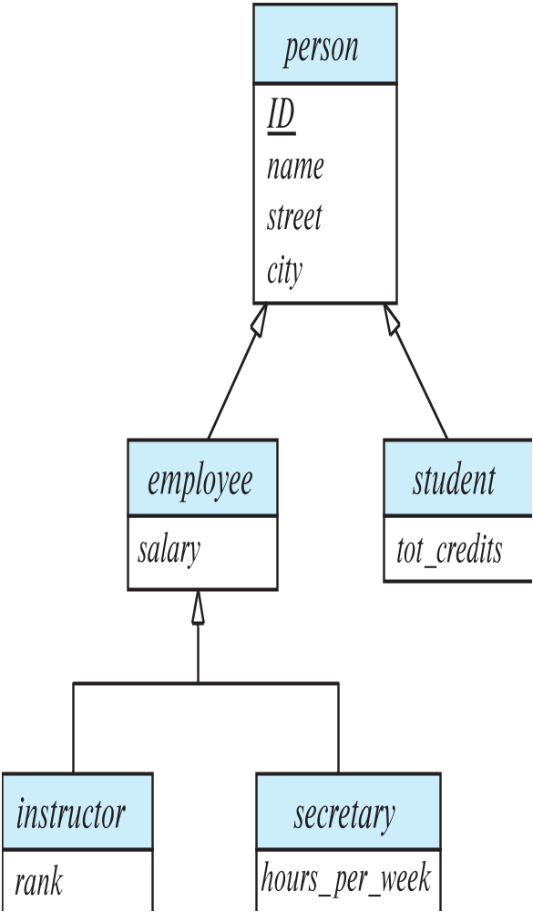
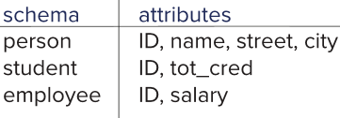
Mapping of Specialization/Generalization
Method 1:
  Form a schema for higher-level entity
  Form a schema for each lower-level entity set, include primary key of higher-level entity set and local attributes
  Drawback: getting information about, an employee requires accessing two relations, one corresponding to low-level schema and one corresponding to high-level schema.

Slide 17
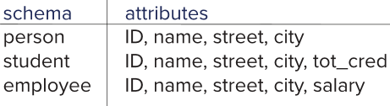
Mapping of Specialization/Generalization
Method 2
  Form a schema for each entity set with all local and inherited attributes.
  Drawback: name, street and city may be stored redundantly for people who are both students and employees.

Slide 18
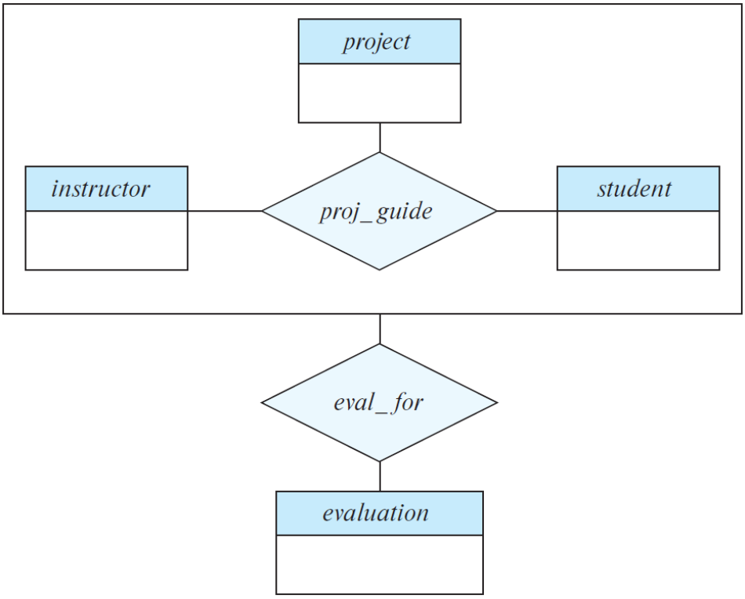
Mapping of Aggregation
To represent aggregation, create a schema containing
  Primary key of the aggregated relationship
  Primary key of the associated entity set
  Any descriptive attributes
In our example:
  Schema eval_for is:
eval_for (s_ID, project_id, i_ID, evaluation_id)
  The schema proj_guide is redundant.

Slide 19
Examples

Slide 20
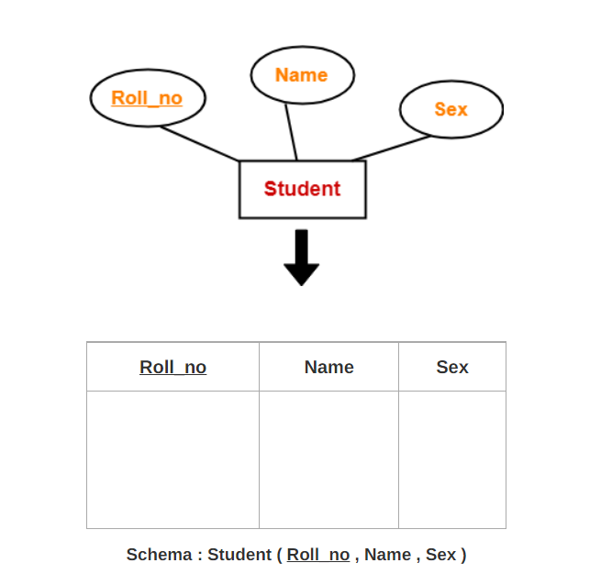
Rule-01: For Strong Entity Set With Only Simple Attributes-
T1: Roll_no, Name, Sex

Slide 21
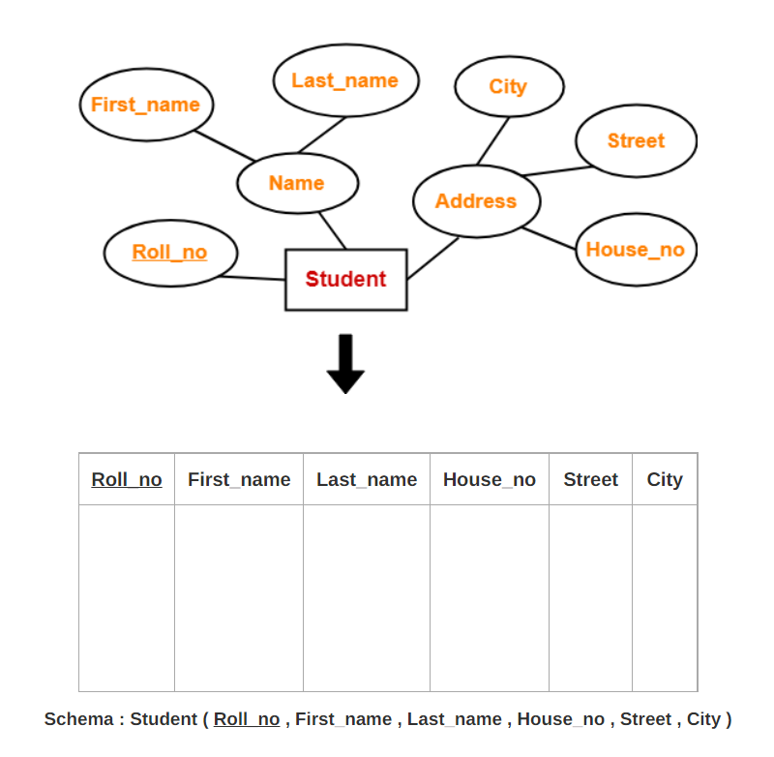
Rule-02: For Strong Entity Set With Composite Attributes-
T1: Roll_No, First_Name, Last_Name, House_no, Street, City

Slide 22

Rule-03: For Strong Entity Set With Multi Valued Attributes-

Slide 23
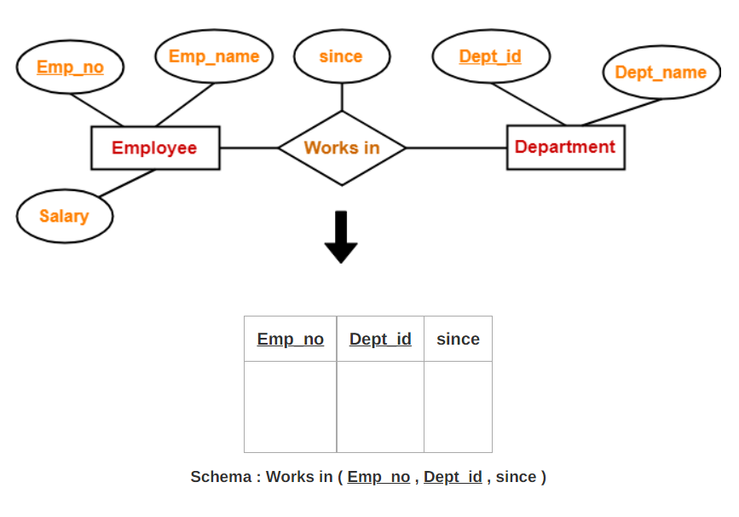
Rule-04: Translating Relationship Set into a Table-
If we consider the overall ER diagram, three tables will be required in relational model-
One table for the entity set “Employee”
One table for the entity set “Department”
One table for the relationship set “Works in”

Slide 24
Rule-05: For Binary Relationships With Cardinality Ratios-
Case-01: Binary relationship with cardinality ratio m:n
Case-02: Binary relationship with cardinality ratio 1:n
Case-03: Binary relationship with cardinality ratio m:1
Case-04: Binary relationship with cardinality ratio 1:1

Slide 25
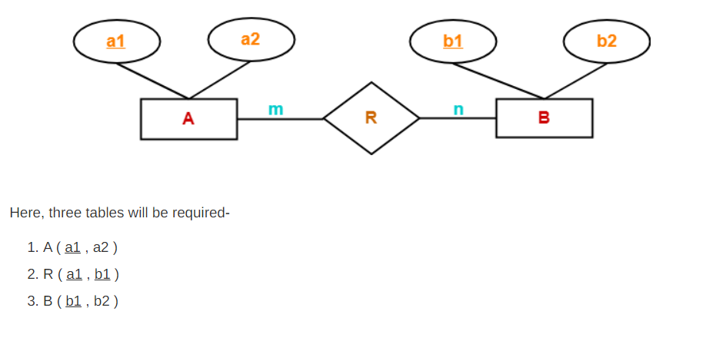
Case-01: For Binary Relationship With Cardinality Ratio m:n

Slide 26
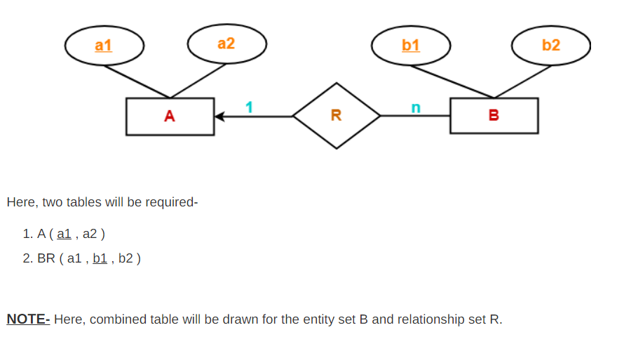
Case-02: For Binary Relationship With Cardinality Ratio 1:n

Slide 27
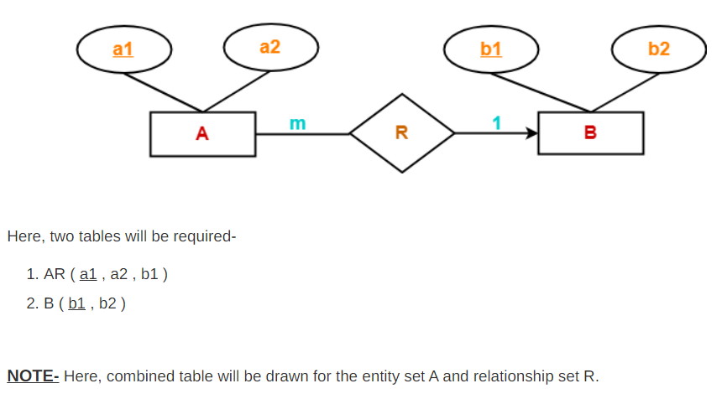
Case-03: For Binary Relationship With Cardinality Ratio m:1

Slide 28
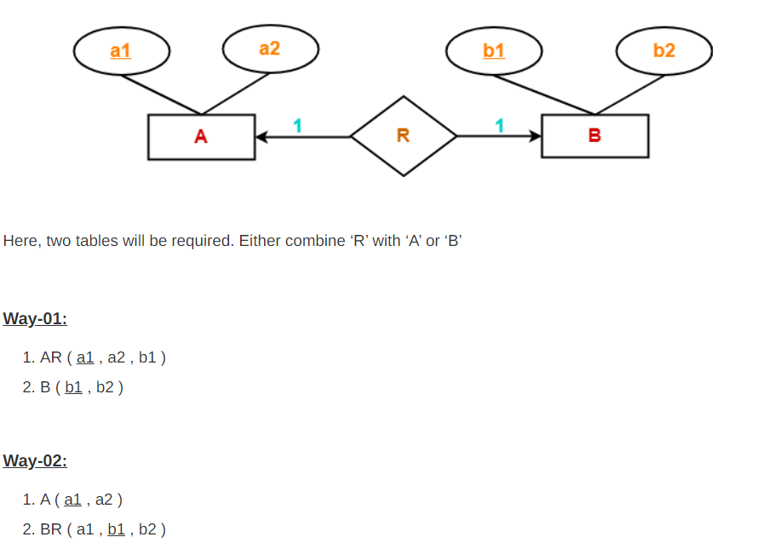
Case-04: For Binary Relationship With Cardinality Ratio 1:1

Slide 29
Mapping of N-ary Relationship Types

Slide 30
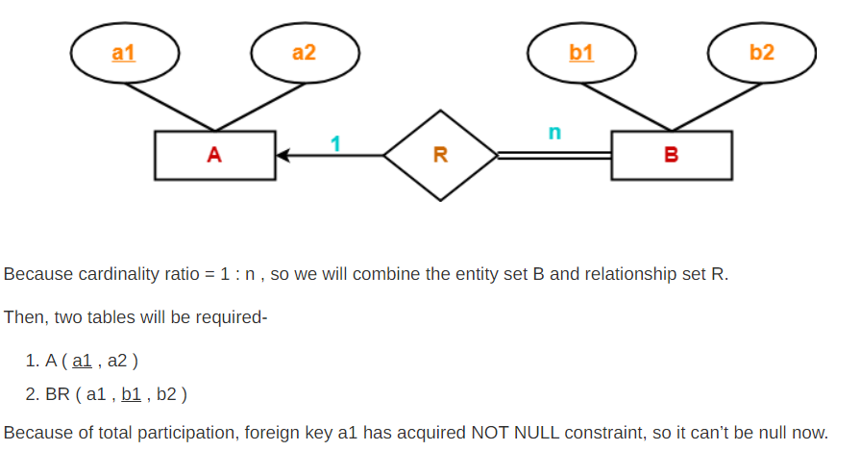
Rule-06: For Binary Relationship With Both Cardinality Constraints and Participation Constraints-
Case-01: For Binary Relationship With Cardinality Constraint and Total Participation Constraint From One Side-

Slide 31
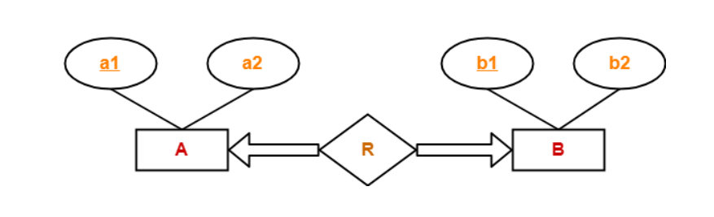
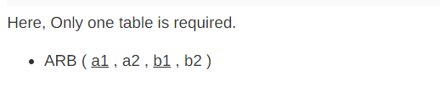
Case-02: For Binary Relationship With Cardinality Constraint and Total Participation Constraint From Both Sides-

Slide 32
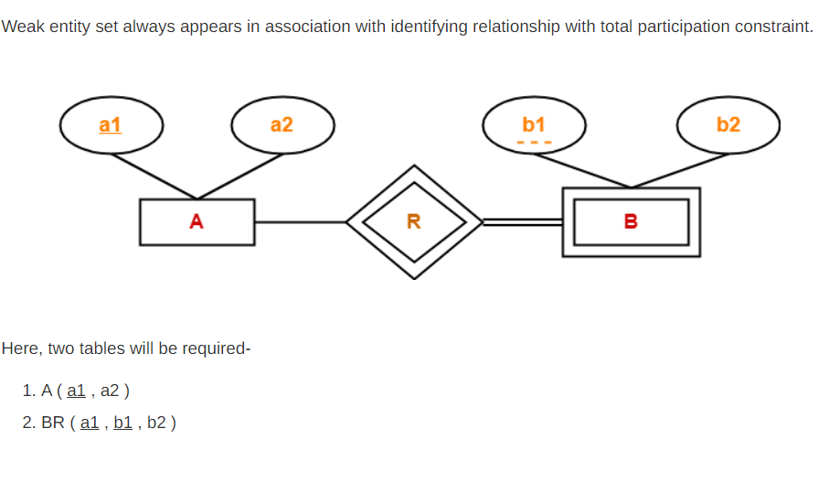
Rule-07: For Binary Relationship With Weak Entity Set-

Slide 33
Mapping of Specialization/Generalization
Method 1:
  Form a schema for higher-level entity
  Form a schema for each lower-level entity set, include primary key of higher-level entity set and local attributes
  Drawback: getting information about, an employee requires accessing two relations, one corresponding to low-level schema and one corresponding to high-level schema.

Slide 34
Mapping of Specialization/Generalization
Method 2
  Form a schema for each entity set with all local and inherited attributes.
  Drawback: name, street and city may be stored redundantly for people who are both students and employees.

Slide 35
Mapping of Aggregation
To represent aggregation, create a schema containing
  Primary key of the aggregated relationship
  Primary key of the associated entity set
  Any descriptive attributes
In our example:
  Schema eval_for is:
eval_for (s_ID, project_id, i_ID, evaluation_id)
  The schema proj_guide is redundant.

